Slide 1

Shape defined Panoramas
John Brosz & Faramarz Samavati
University of Calgary
Shape Modeling International – June 2010

Slide 2
Outline
Scenario/Motivation
Goals
Related Work
Observations
Projection Surface Formulation
Rendering
Applications

Slide 3
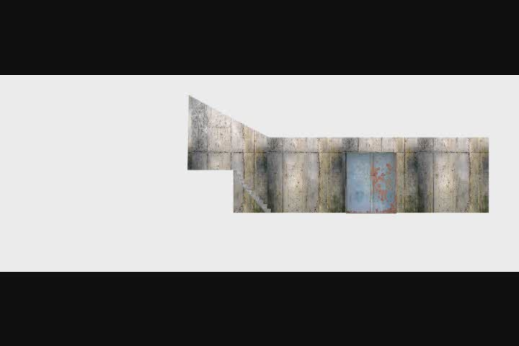
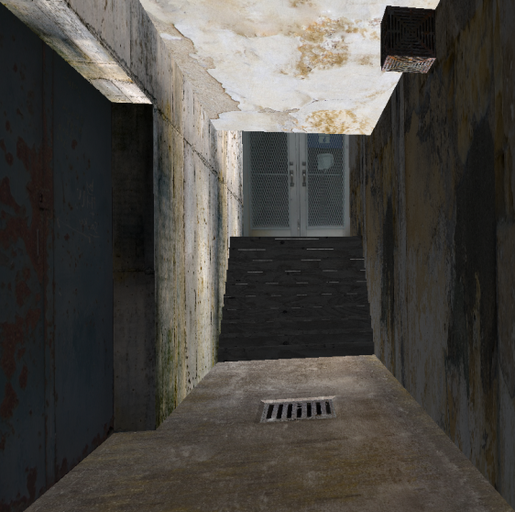

Slide 4
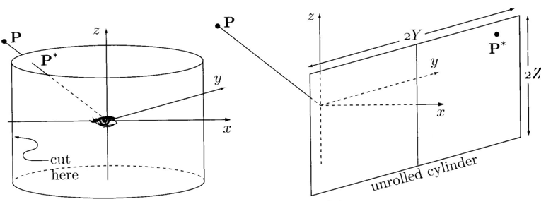
Figure from Transformations & Projection in Computer Graphics, Salomon, Springer, 2006

Slide 5
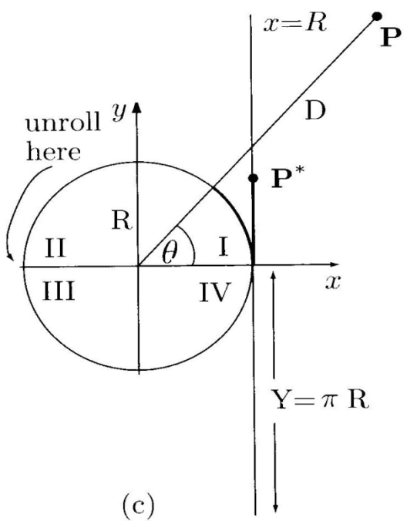
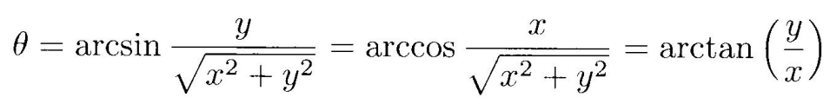
i = R
Figure from Transformations & Projection in Computer Graphics, Salomon, Springer, 2006

Slide 6



z
j = +
( i, j ) = ( R , , + )
Figure from Transformations & Projection in Computer Graphics, Salomon, Springer, 2006

Slide 7
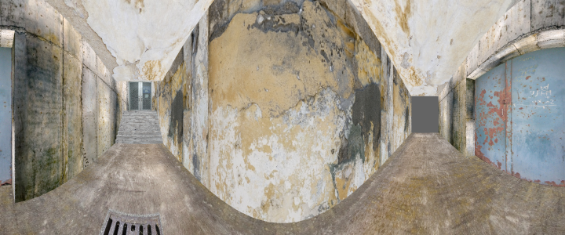
Notes:
This cylindrical projection gives us the following image. While much better than perspective, it still has a few drawbacks that we would like to correct: (1) the bend in the wall is very sharp (2) we cannot see the top of the walls close to the viewpoint. So we need to do something else to correct these problems. How about trying a spherical projection?

Slide 8
Notes:
This cylindrical projection gives us the following image. While much better than perspective, it still has a few drawbacks that we would like to correct: (1) the bend in the wall is very sharp (2) we cannot see the top of the walls close to the viewpoint. So we need to do something else to correct these problems. How about trying a spherical projection?

Slide 9



Spherical Projection Equation
( i, j ) =

Slide 10
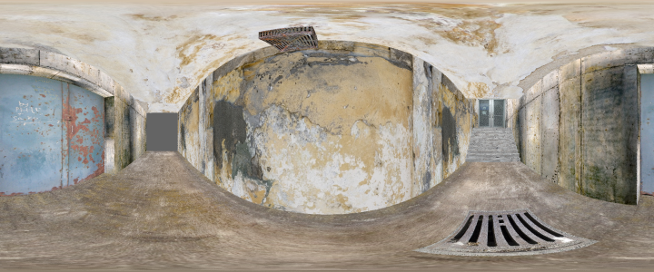
Notes:
This is the result of the spherical projection but it is not exactly what is wanted either because (1) I don’t like the bulg in that wall (2) there is too much stretching near the ceiling and floor.

Slide 11
Notes:
This is the result of the spherical projection but it is not exactly what is wanted either because (1) I don’t like the bulg in that wall (2) there is too much stretching near the ceiling and floor.

Slide 12
Notes:
This is the result of the spherical projection but it is not exactly what is wanted either because (1) I don’t like the bulg in that wall (2) there is too much stretching near the ceiling and floor.

Slide 13
Notes:
This is the result of the spherical projection but it is not exactly what is wanted either because (1) I don’t like the bulg in that wall (2) there is too much stretching near the ceiling and floor.

Slide 14
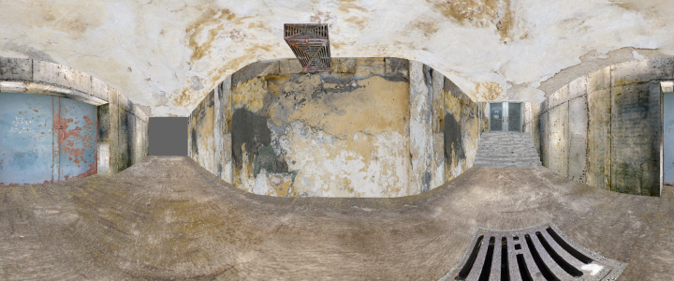

Slide 15
Goals
Create panoramas that:
Allow for exploration & customization
Are defined by modeling
Build on existing intuition
Allow for visual understanding
Single Viewpoint: no “slit cameras”.

Slide 16
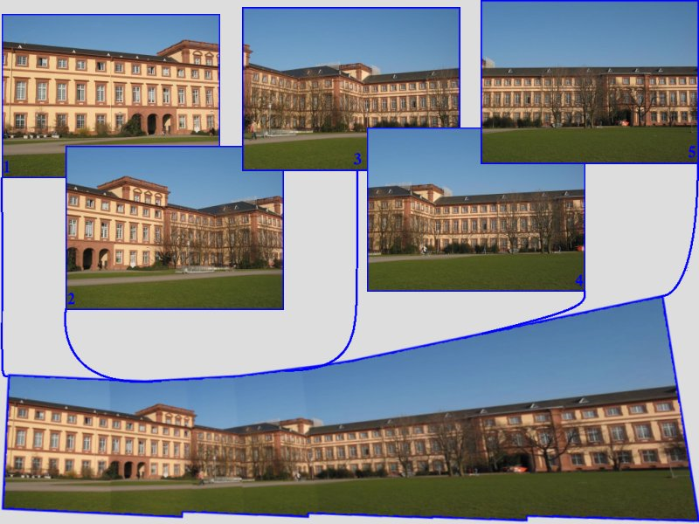
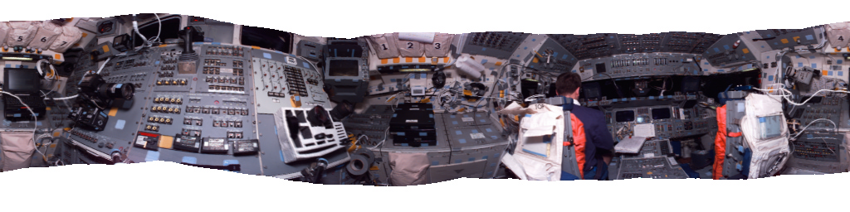
Related Work
Panoramas from Perspective
Images
Image from http://www.cirq.de/mosaicing.html
Image from Szeliski & Shum, Creating full view panoramic image mosaics and environment maps, Siggraph 1997

Slide 17
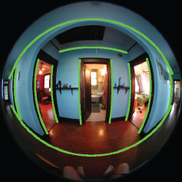
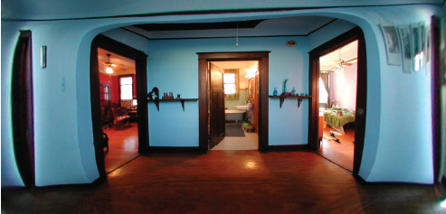
Related Work
Correcting Distortion
Images from Carrol, Agrawala & Agarwala, Optimizing Content-Preserving Projections for Wide-Angled Images, Siggraph 2009

Slide 18

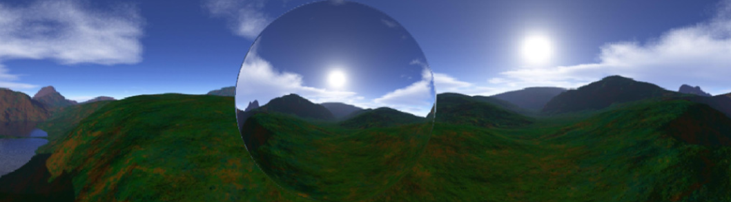
Related Work
Single-Center Projections
Normal Map
Panorama
Images from Trapp & Döllner, Generalization of Single-Center Projections Using Projection Tile Screens, VISIGRAPP, 2008
Notes:
The work closest in concept to ours is Single-Center Projection by Trapp & Doellner.

Slide 19
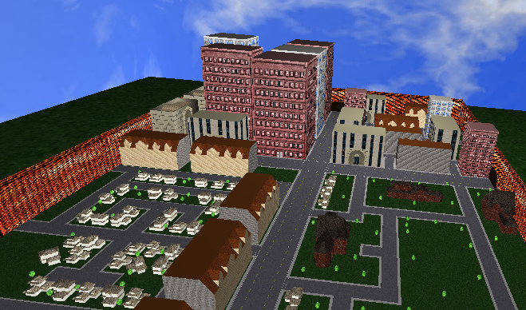
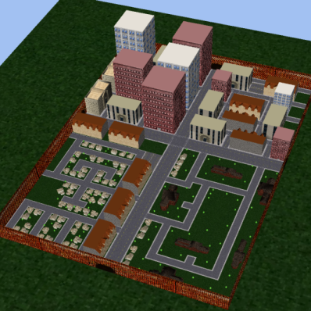
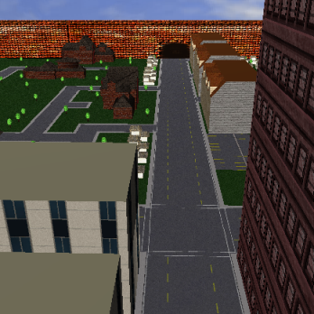

Slide 20
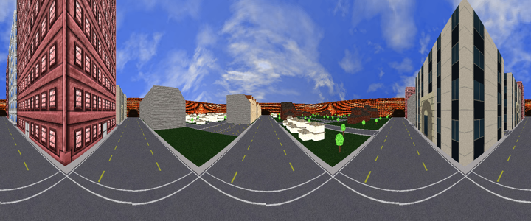
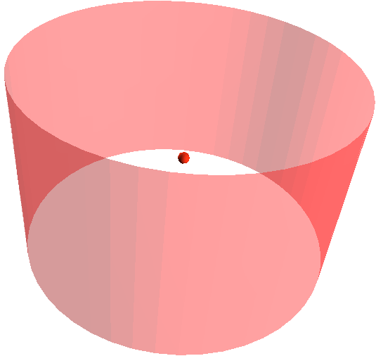
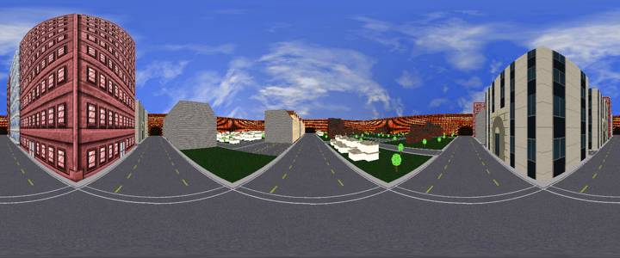
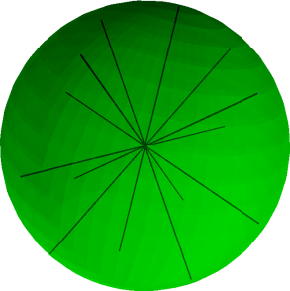
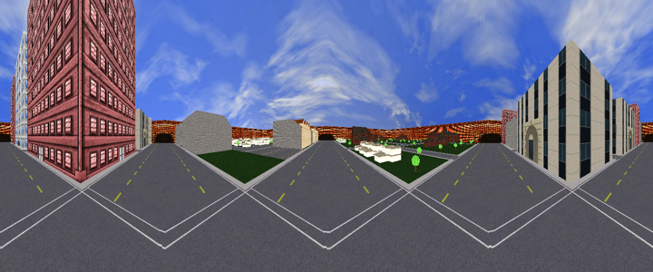
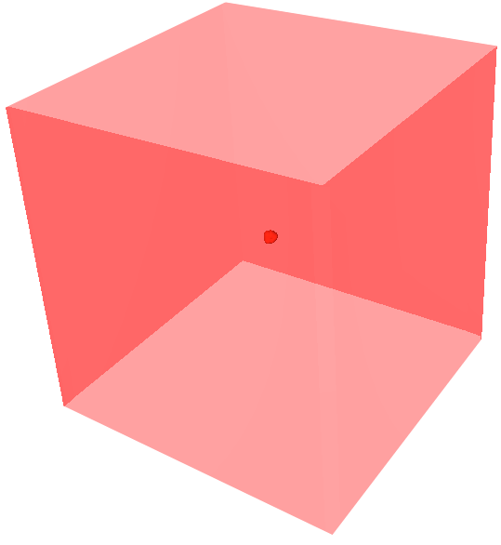
Common Panoramas

Slide 21
Observations
Shapes are associated with panoramas

Slide 22
Observations
Shapes are associated with panoramas
Angular change

Slide 23
Observations
Shapes are associated with panoramas
Angular Change
Parameterization is important
( i, j ) = ( R , , + )
( i, j ) =

Slide 24
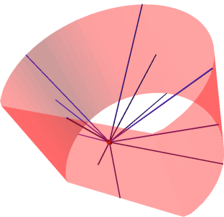
Shape Defined Panoramas
Defined by two curves
  Outline: closed, controls horizontal sampling

Slide 25
Shape Defined Panoramas
Defined by two curves
  Outline: closed, controls horizontal sampling

Slide 26
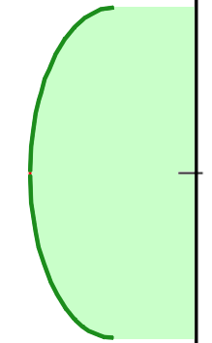
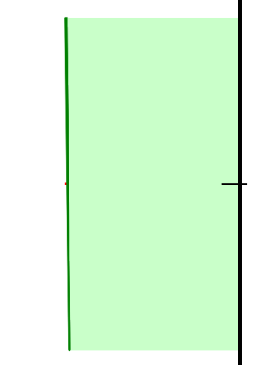
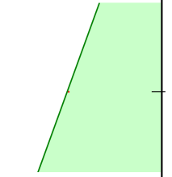
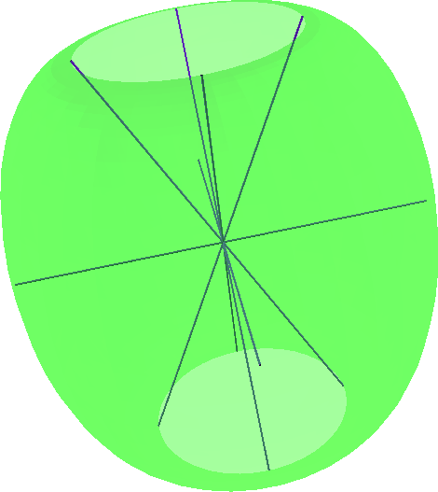
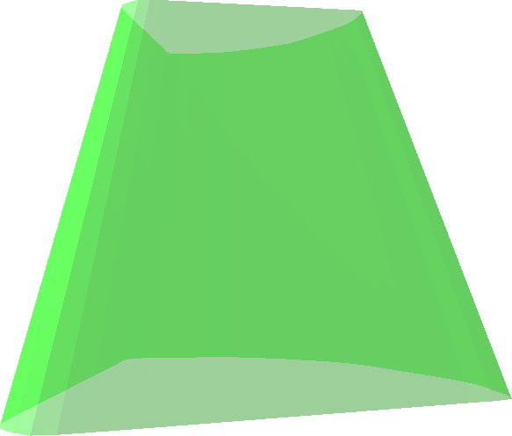
Shape Defined Panoramas
Defined by two curves
  Outline: closed, controls horizontal sampling
  Profile: open, controls vertical sampling

Slide 27
Shape Defined Panoramas
Defined by two curves
  Outline: closed, controls horizontal sampling
  Profile: Open, controls vertical sampling
Curves parameterized by arc-length
Notes:
We can discretize the curve, adjust the space between samples based on arc-length

Slide 28
Shape Defined Panoramas
Mix between surface of revolution and surface extrusion
Outline
Profile
Extrusion Surface

Slide 29
Shape Defined Panoramas
Mix between surface of revolution and surface extrusion
Outline
Profile
Panorama Surface

Slide 30
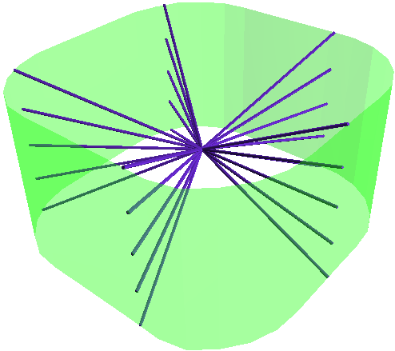
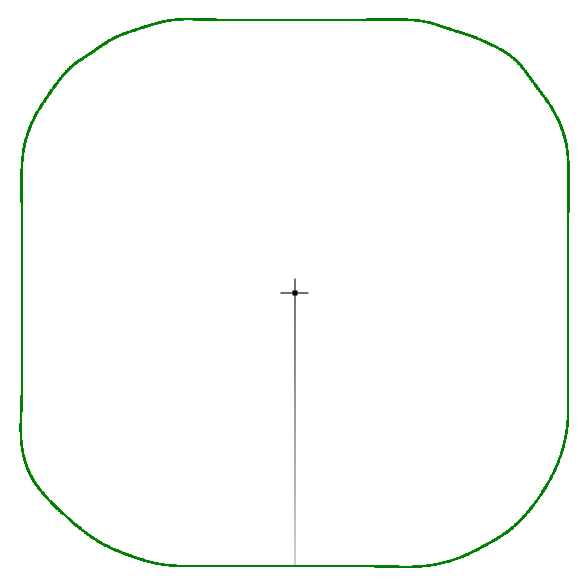

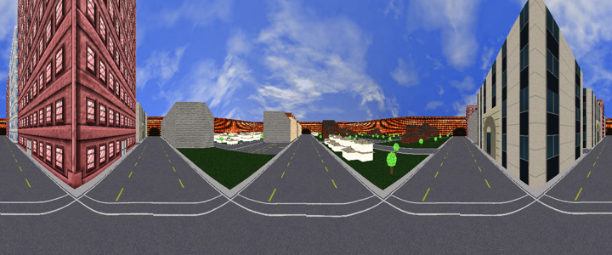
Example 1
Outline
Profile

Slide 31
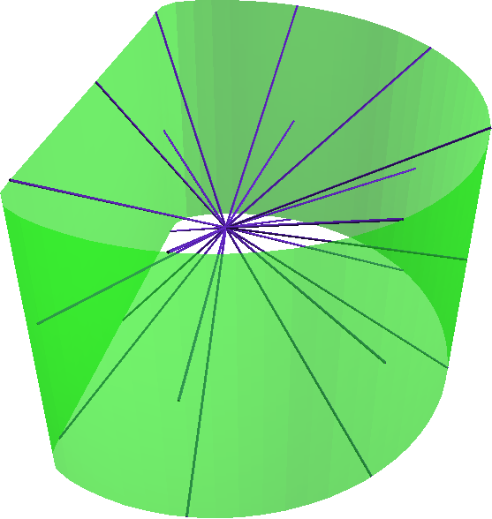
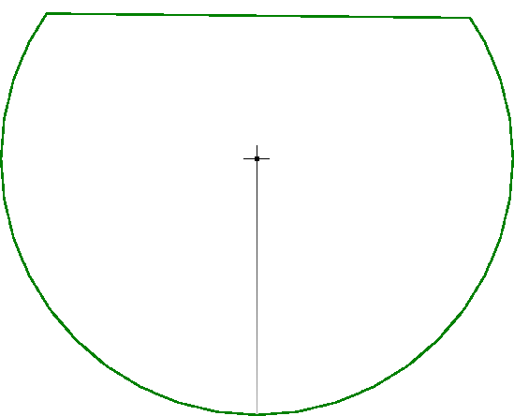
Example 2
Outline

Slide 32
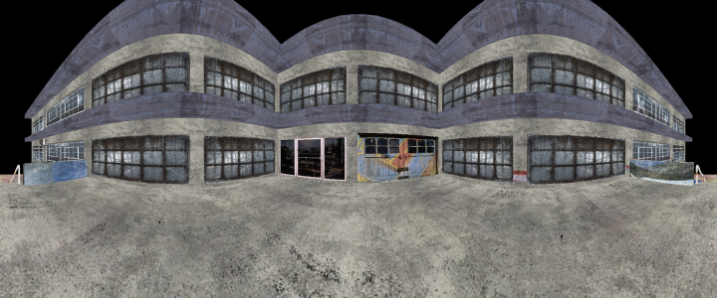
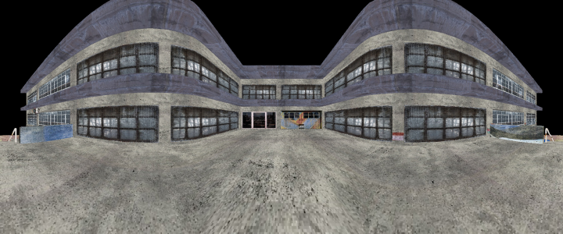

Example 2
Before
After

Slide 33
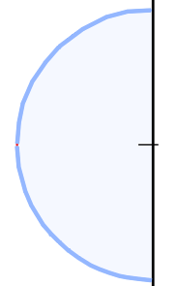
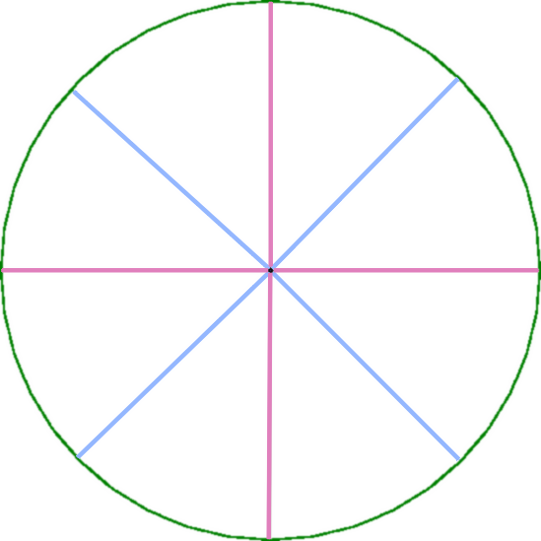
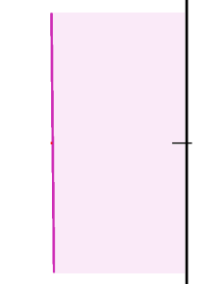
Shape Defined Panoramas
Multiple Profiles

Slide 34


Shape Defined Panoramas
Multiple Profiles

Slide 35
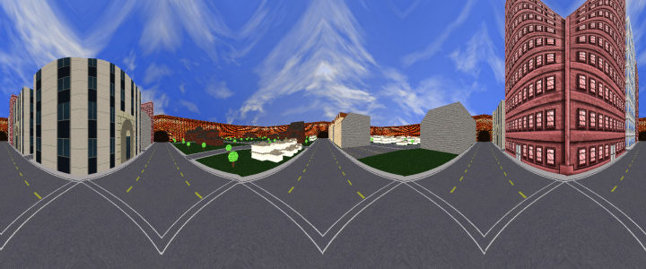

Slide 36
Rendering
Ray-tracing
Image Re-sampling
Nonlinear Projection on GPU

Slide 37
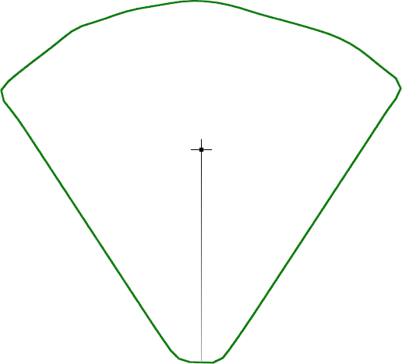

Rendering
Ray-tracing
x
x

Slide 38

Rendering
Image Re-sampling

Slide 39
Rendering
Nonlinear Projection on GPU
  Find projection equation
  Project vertices with equation on GPU
  Be careful with seams

Slide 40
Find Projection Equation
  World Coordinates Normalized Device Coordinates

Slide 41
Find Projection Equation
  Only surfaces that map onto spherical coordinates.
  Projection Surface: Q(u,v) = (x,y,z)
  Projection Volume: t (0,0,0) + (1-t) Q(u,v)
  Find spherical coordinates of p = (x,y,z)
  Search for u,v s.t. Q(u,v) with same spherical coords.
  t = || p ||
  || Q(u,v) ||

Slide 42
Find Projection Equation
  Search for u,v s.t. Q(u,v) with same spherical coords.

Slide 43
Project Vertices with GPU
  Override projection matrix with nonlinear projection equation.
  This only moves vertices! Triangles are filled as if linearly projected.
Nonlinearly Projected
Triangle
Triangle w/ Linear
Fill Algorithm

Slide 44
Seams

Slide 45
Seams

Slide 46
Rendering Performance
Single pass algorithm
60 fps with 100K polygons on NVIDIA 8800 GTS

Slide 47
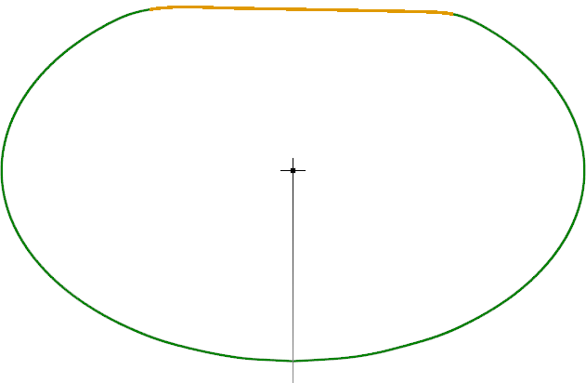
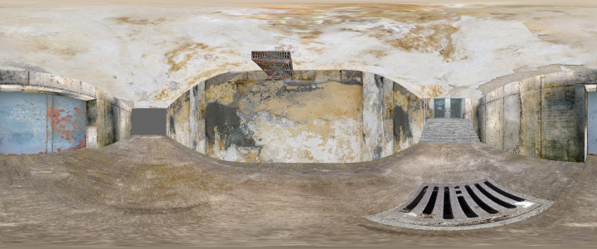
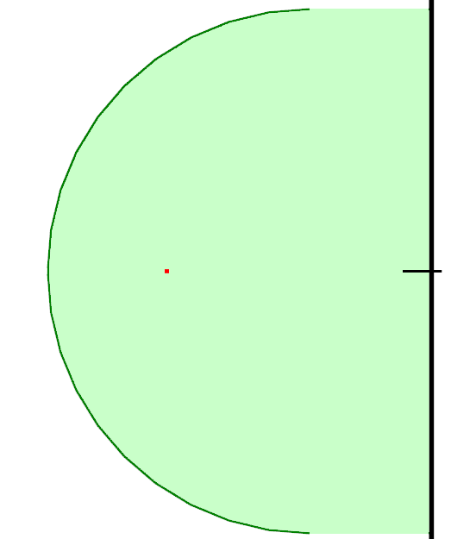
Application:
Custom Panorama
Notes:
Freedom to choose & explore between different options

Slide 48

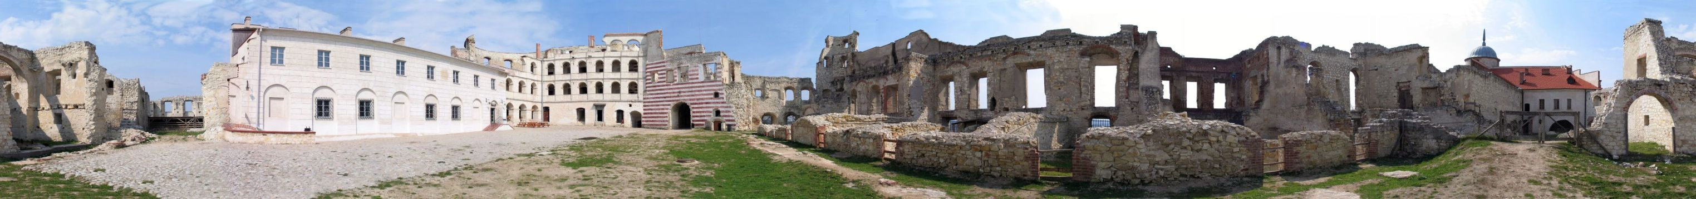
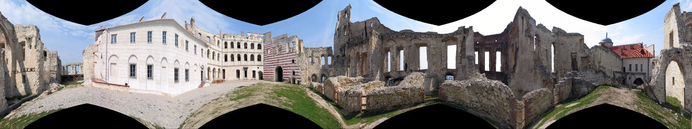
Application:
Re-projecting Panoramas

Slide 49
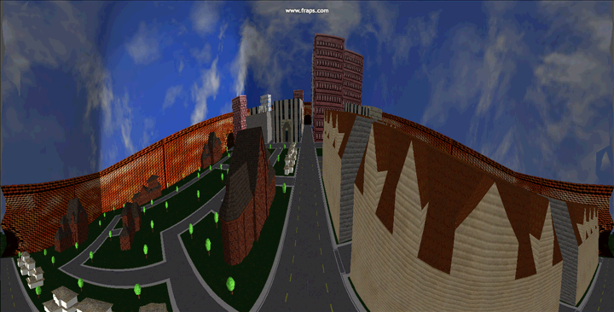
Application:
Animated Projection

Slide 50
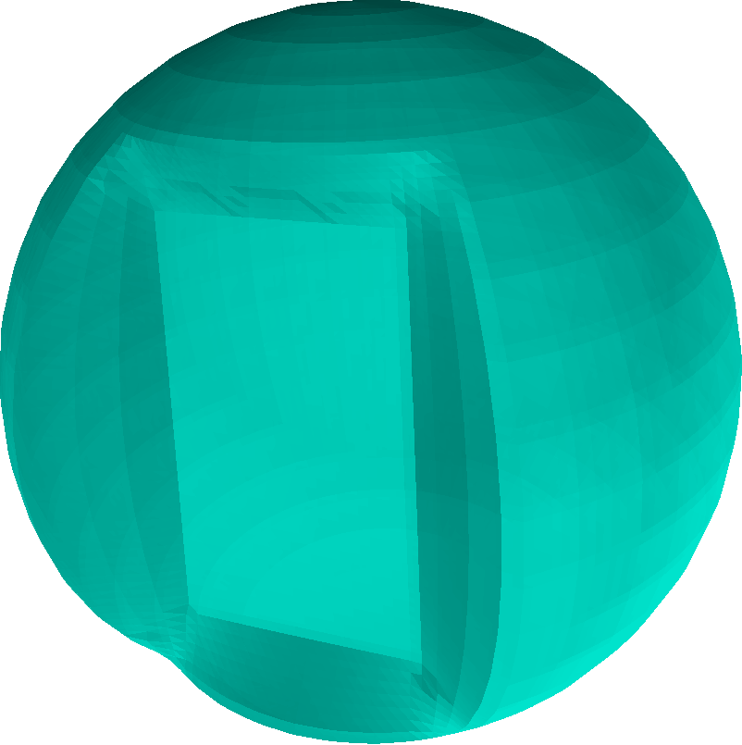
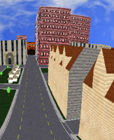
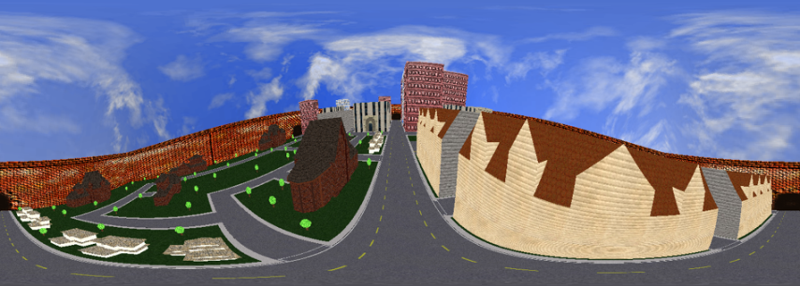
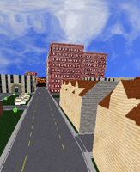

Application:
Interactive Local Editing

Slide 51

Application:
Interactive Local Editing

Slide 52
Conclusions
Use of modeling to define a projection.
Use of Arc-length to dictate parameterization.
Visual means for creating panoramas.
Realtime GPU based rendering of panoramas.

Slide 53
Thank-You

